Slide 1
IT3011 · TPSM
Customers who
Receive timely updates feel more confident about service
A statistical study using the Red Wine Quality dataset

Slide 2
Problem Statement
" Customers who receive timely updates feel more confident about the service."
Real-world problem
Research question
Our dataset
In hospitality, slow responses to guest requests (room service, maintenance, etc.) damage trust and satisfaction.
Does service response time significantly affect customer satisfaction (quality score)?
3000 customer response samples.
IT3011 · Theory and Practices in Statistical Modelling

Slide 3
Objectives
01
Perform descriptive analysis and visualizations of all key variables and external factors.
02
Quantify the relationship between service response time and customer satisfaction using correlation, regression, and ANOVA on High/Medium/Low timeliness groups.
03
Assess the impact of external environmental and behavioural factors using t‑tests and ANOVA, and validate robustness with a multiple regression model that controls for all external predictors.
04
Test and decide the hypothesis, “Customers who receive timely updates feel more confident about the service.”
IT3011 · Theory and Practices in Statistical Modelling

Slide 4
Data Collection
3000
14
1
0-100
Observations
Total Columns
Target Variable
Quality Score Scale
Key Variables
Data Source
Variable | Type | Role
noice level db | Continuous | Independent
service request count | Continuous | Independent
timeliness group | Categorical | Independent
door opened | Categorical(Binary) | Independent
motion detected | Categorical(Binary) | Independent
service response time min | Continuous | Main Independent (key)
service quality score | Continuous | Dependent (target)
Source ( Kaggle ) : Accommodation Service Quality & Sensor Dataset.
Type: Secondary dataset
Collection: A collection of accommodation sensor data matched with hotel room conditions and timely service interactions.
IT3011 · Theory and Practices in Statistical Modelling

Slide 5
Data Preprocessing & Cleaning
1
Missing value check
Feature engineering
Created two new categorical variables.
Timeliness_Group (High ≤15 min, Medium 16–40 min, Low >40 min) from service_response_time_min.
Noise_Group (Quiet ≤40 dB, Moderate 41–70 dB, Noisy >70 dB) from noise_level_db.
Original dataset: 22 missing values confirmed via sum(is.na())
2
Duplicate records check
Applied sum(duplicated(data)) returned 0 – no duplicate rows.
Key design principle
3
Outlier detection
All variables were cleaned and properly typed prior to testing. Following the removal of 22 missing values and 21 outliers, the final dataset was reduced from 3,000 to 2,957 rows. Factors were utilized for group comparisons, and continuous predictors remained unscaled in regression to preserve direct interpretability.
IQR method applied to all numeric variables – 21 outliers found.
4
Data type conversion
motion_detected, door_open converted to factors for appropriate statistical testing.
IT3011 · Theory and Practices in Statistical Modelling

Slide 6
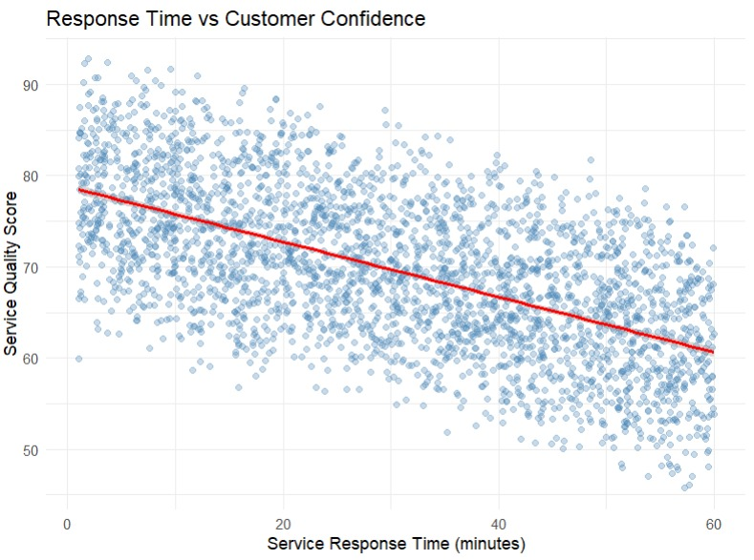
Descriptive Analysis
Summary statistics — key features
Feature | Mean | Std Dev | Min | Max
Service quality score | 69.62 | 8.56 | 45.75 | 92.82
Service response time min | 30.35 | 16.96 | 1.02 | 60.00
noise level db | 55.23 | 20.15 | 20.15 | 89.97
air quality index | 69.95 | 28.48 | 20.01 | 119.99
service request count | 2.00 | 1.43 | 0 | 4
Key descriptive findings
Service Quality Score ranges from 45.75 to 92.82 (mean 69.62, SD 8.56) – moderate spread, indicating real differences in customer confidence.
Response Time varies widely from 1.02 to 60.00 minutes (mean 30.35, SD 16.96) – service speed differs greatly across observations.
Noise Level (mean 55.23 dB, SD 20.15, max 89.97) and Air Quality Index (mean 69.95, SD 28.48, max 119.99) show large variability – room environments are far from uniform.
Air quality and noise level also negatively correlate with satisfaction .
Temperature is relatively stable (mean 24.98°C, SD 3.99) – most rooms remain within a narrow comfort zone.
IT3011 · Theory and Practices in Statistical Modelling

Slide 7
Inferential Analysis — Hypothesis Testing
H₀ — Null Hypothesis
H₁ — Alternative Hypothesis
Timely updates have no significant effect on customer confidence
Timely updates significantly increase customer confidence.
Tests Applied
Pearson correlation
One‑way ANOVA (Timeliness_Group & Noise_Group)
Independent t‑tests (door_open, motion_detected)
Simple linear regression
Multiple linear regression (all external factors controlled)
Decision rule
p < 0.05 → Reject H₀
p ≥ 0.05 → Retain H₀ (investigate further)
IT3011 · Theory and Practices in Statistical Modelling

Slide 8
Inferential Analysis
Correlation Analysis – Pearson(-1 to +1)
One- way ANOVA -
Service response time min Vs service quality score
Pearson r = –0.60 → strong negative relationship
p < 2.2e‑16 → Significant
service response time increases, customer confidence (quality score) tends to decrease.(reject H0)
1.timeliness group (High / Medium / Low) Vs service quality score
F(2, 2997) = 699.5, p < 2e‑16 → significant difference
Tukey HSD (all p < 0.001):
Medium‑High = –5.69 (Medium scores 5.7 points lower than High)
Low‑High = –12.69 (Low scores 12.7 points lower than High)
Low‑Medium = –7.01 (Low scores 7.0 points lower than Medium)
2.noice group (Quiet / Moderate / Noisy) Vs service quality score
F(2, 2997) = 76.33, p < 0.001 → significant difference
Tukey HSD (all p < 0.001):
Moderate‑Quiet = –2.36
Noisy‑Quiet = –4.99
Noisy‑Moderate = –2.64.(reject H0)
ANOVA Interpretation
Customers in the High timeliness group report significantly higher satisfaction than those in Medium or Low groups.
Quiet rooms show the highest satisfaction; noise significantly reduces confidence.
Both results support rejecting H₀ – timely updates (and quiet environments) matter.
The order is: Quiet > Moderate > Noisy (and the gaps are statistically significant)
IT3011 · Theory and Practices in Statistical Modelling

Slide 9
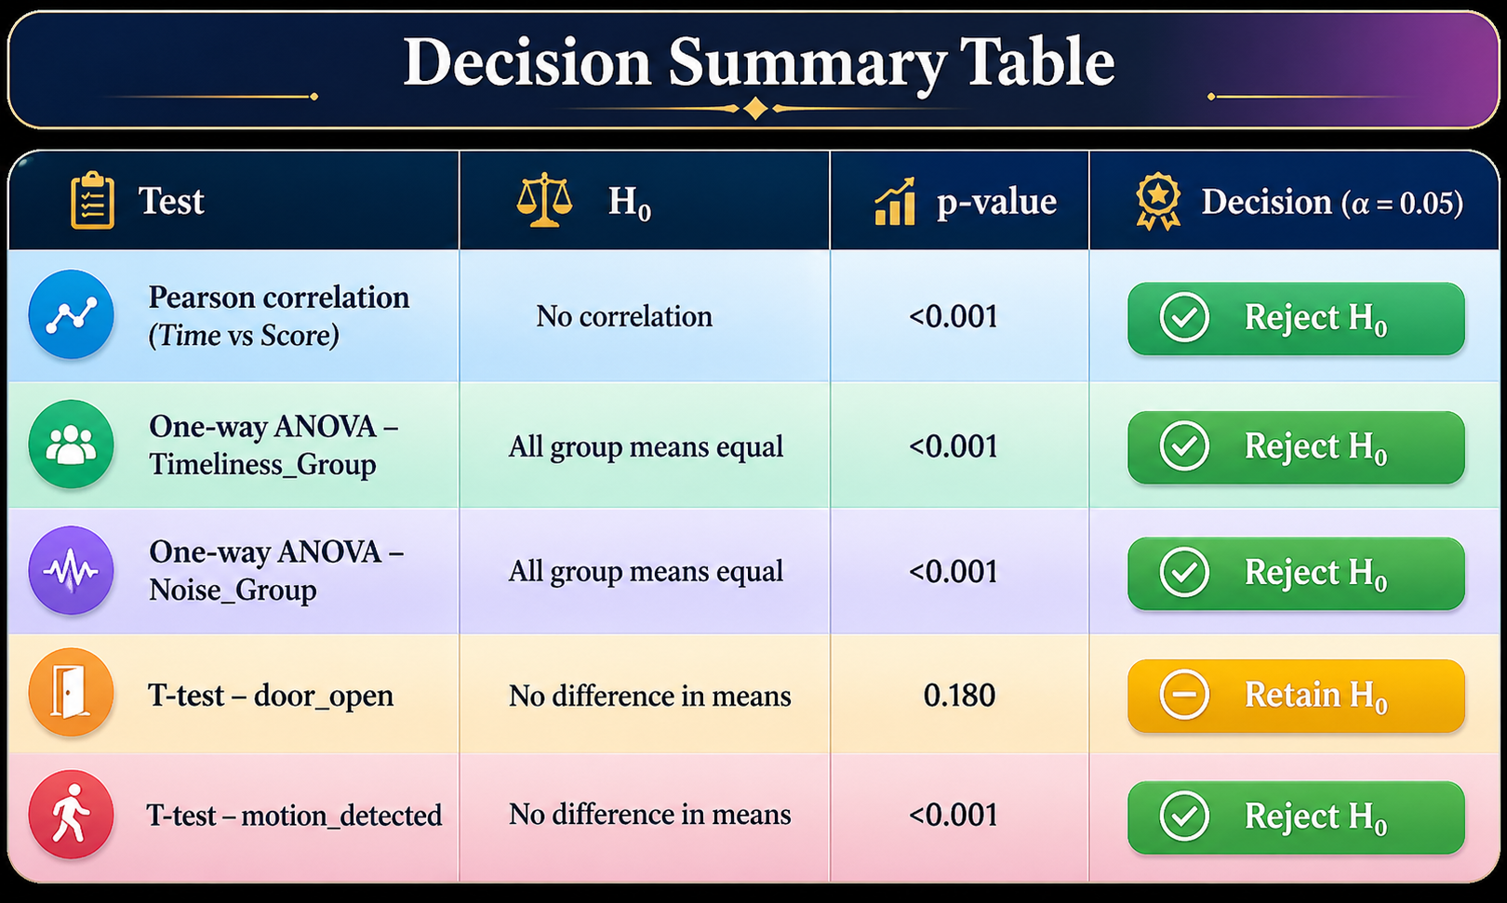
Inferential Analysis
T-tests
1. door open Vs service quality score
Group 0 (closed): Mean = 69.83
Group 1 (open): Mean = 69.41
t(2997.8) = 1.34, p = 0.18 → Not significant
Door status does not significantly affect customer confidence.
2. motion detected(Quiet / Moderate / Noisy) Vs service quality score
Group 0 (no motion): Mean = 68.57
Group 1 (motion): Mean = 70.71
t(2995.2) = –6.89, p < 0.001 → Significant
Occupied rooms (motion = 1) report slightly higher satisfaction.(reject H0)
IT3011 · Theory and Practices in Statistical Modelling

Slide 10
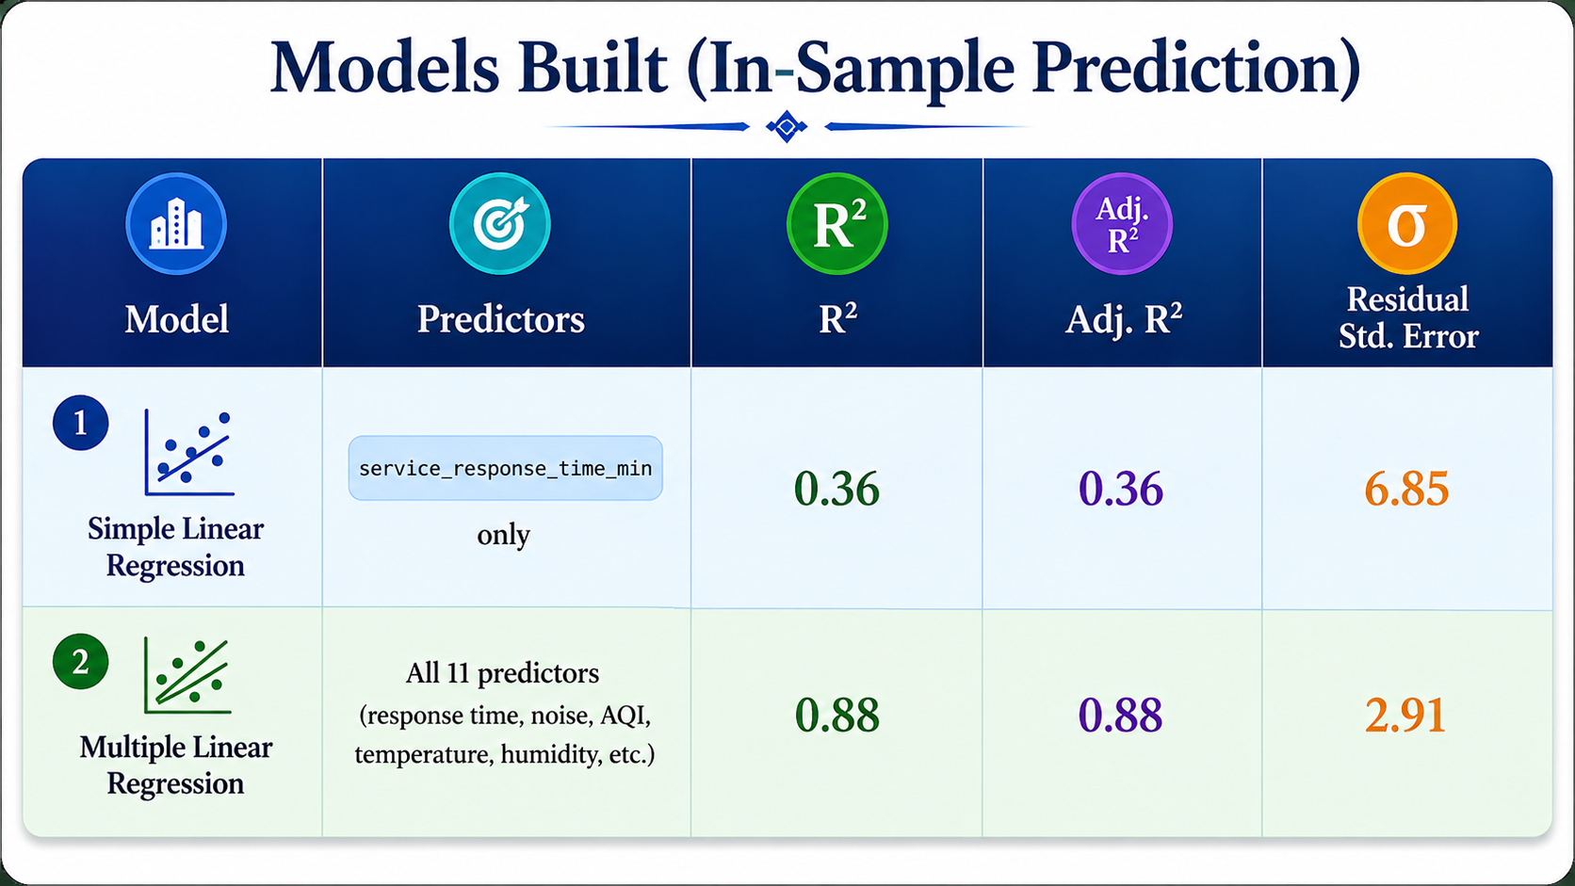
Predictive Model
Linear Regression
Multiple Regression
Predicting customer confidence from response time only
Predicting customer confidence from all 11 predictors
IT3011 · Theory and Practices in Statistical Modelling

Slide 11
Final Decision
We reject H₀
“Customers who receive timely updates feel more confident about the service”.
Analytics Type | Evidence | Verdict
Descriptive | High‑timeliness group shows mean quality score ≈75, Low group ≈64; response time and satisfaction are visibly negatively correlated in scatterplots. | Supports H1
Inferential | Correlation is strong and negative (r = –0.60). ANOVA confirms groups differ clearly. Even after accounting for external factors, response time still matters significantly. | Supports H1
Predictive | Simple regression R² = 0.36 (each minute → –0.30 points); Full model R² = 0.88 demonstrates strong predictive power, with response time always a key negative predictor. | Supports H1
IT3011 · Theory and Practices in Statistical Modelling

Slide 12
Conclusion
This study confirms that timely updates significantly increase customer confidence, even after controlling for environmental and behavioural factors.
Findings
Strong negative correlation (r = –0.60) between response time and satisfaction
High‑timeliness customers score roughly 12 points higher than low‑timeliness customers (ANOVA, p < 0.001)
Every extra minute of waiting reduces satisfaction by about 0.30 points (simple regression, p < 0.001)
Response time remains a significant predictor (b = –0.30) in the full model (adj. R² = 0.88) after controlling all other factors
Noise and air quality also reduce confidence; door status does not
IT3011 · Theory and Practices in Statistical Modelling

